Slide 1
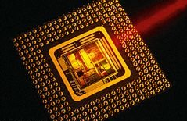
AC22005
Section 2 - Lecture 10
Microprocessors 4 (other bells and whistles)
IT’S ALL ABOUT SPEED!

Slide 2
Outline of today’s lecture
  Super-scalar architecture
  Other processor developments
  Reference: Stallings, “Computer Organization and Architecture” (5th Ed.), pp. 419-433.

Slide 3

Thought for the Day

Slide 4

Graph of the Day

Slide 5
Revision
The use of pipelining delivers instruction-level parallelism - processing instructions on a “production line” inside the CPU to deliver completed instructions more frequently.
Pipelining is internal to the CPU, and the user/programmer/operating system do not need to do anything differently depending on whether pipelining is used or not.
However, due to stalling, we can’t push this technology any further than we already have!

Slide 6
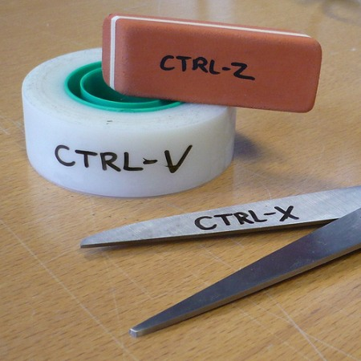
Super-scalar Architecture

Slide 7
Super-scalar architecture
To increase CPU speed, we can simply duplicate hardware components – this is called super-scalar architecture:
  duplicate pipelines within the CPU and/or
  duplicate whole CPU cores
We then achieve greater throughput by utilising these components in parallel, each working on their own instruction sequence – this is thread-level parallelism.

Slide 8
Super-scalar architecture
The Pentium has two integer pipelines, called U and V. Each pipeline has its own ALU, allowing them to operate in parallel (though they are not quite the same).
The Pentium performs almost twice as fast as the 80486 on integer instructions - the two CPUs have similar, five-stage integer pipelines (but the Pentium has two of them).
A floating-point pipeline is also included to handle floating-point calculations.

Slide 9

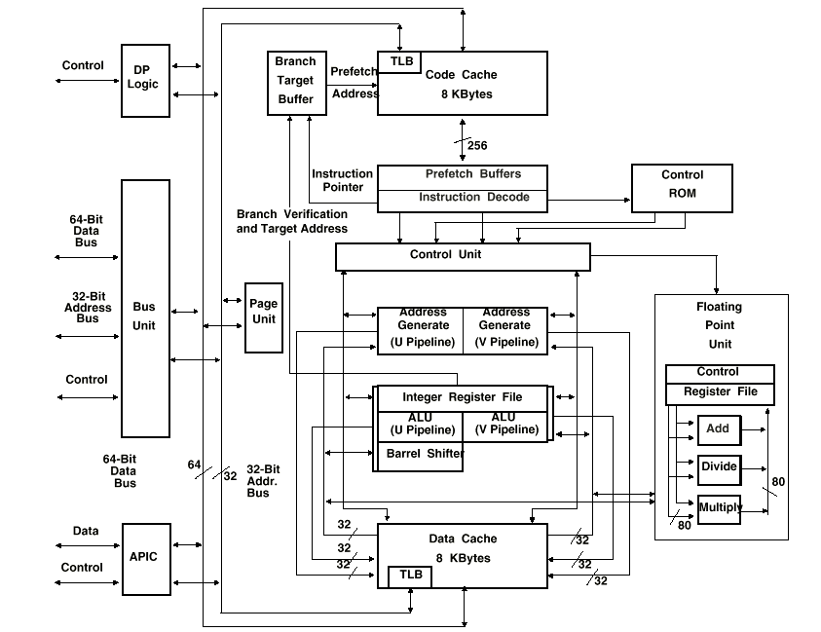
Pentium architecture

Slide 10
Pentium (integer) pipeline
Five stages in a Pentium (integer) pipeline are:
  Pre-fetch instruction
  Decode Stage 1: identifies op-code and extracts addressing information; also performs branch prediction, checks instruction pairing for the pipelines
  Decode Stage 2: calculates memory address (effective addresses)
  Execute
  Write Back

Slide 11
Pentium Instruction Pairing
Rules govern whether or not two instructions can be fed into the two pipelines at the same time (handled by the pre-fetcher):
  there must be no data dependencies between the two instructions
  V instruction must be “simple” (typically data move, add, subtract, increment, decrement, Boolean instructions etc.)
There are certain other more complicated restrictions to reduce stalling.

Slide 12
Pentium Instruction Pairing
A pairing check is performed by the first stage of the instruction decoding to see if two instructions from the program can be allowed to enter the pipelines simultaneously.
The use of pairing attempts to reduce the number of stalls that would otherwise occur.

Slide 13
Multicore
Recently the super-scalar concept has moved on to duplicating entire processor cores within the same CPU:
  Pentium D (2005) - two Pentium 4 cores
  Core Duo (2006) - two Pentium M cores
  Core 2 Duo (2006) - two Core Duo cores
  Core i7 (2011) - 2, 4 or 6 cores
  Sun UltraSPARC T1 (2005) - 4, 6 or 8 cores, each can handle 4 threads

Slide 14
Even more cores
This trend can continue externally, with multiple CPUs fitted to motherboards.
All achieve greater throughput by increasing the volume of processing available.
To exploit this fully, we need to have program sections which can be executed independently – these are threads.

Slide 15

Meet the Family
First release | Name | Microarchitecture | Lithography
1993 | Pentium | P5 | 0.8-0.35μm
1993 | Pentium MMX | P5 | 0.35-0.25μm
1995 | Pentium Pro | P6 | 0.5-0.35μm
1996 | Pentium II | P6 | 0.35-0.25μm
1999 | Pentium III | P6 | 0.25-0.18μm
2000 | Pentium IV | Netburst | 180-65nm
2003 | Pentium M | P6 | 90-65nm
2005 | Pentium D | Netburst | 90-65nm
2007 | Pentium Dual | Yonah | 65-45nm
2008 | Core | Nehalem | 32nm
2011 | Core | Sandy Bridge | 32nm
2012 | Core | Ivy Bridge | 22nm
Originally, there was one CPU model available at a time … now there are many variants on each model, with a range of capabilities/prices.
Celeron (cheap), Core (power), Xeon (server)

Slide 16
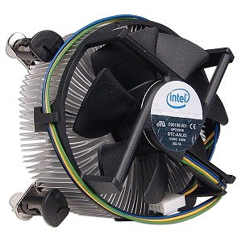
Another reason for multicore

Slide 17
Meltdown
“Power” is a function of (transistors switched x clock frequency) - a deeper pipeline increases “power” via more transistors switching, multiple pipelines increase “power” via more transistors switching …
… and we have increasing clock speeds …
… but each transistor switching uses energy – so heat release per unit area is increasing, so heat dissipation now becoming critical!

Slide 18
Power - examples
Pentium, 75MHz – 8W
Pentium II, 266MHz – 17W
Pentium III, 550MHz – 40W
Pentium IV, 1.8GHz – 67W
Pentium D, 3GHz – 95W
Core 2 Duo, 3GHz – 35W
As all of these chips are roughly the same size, the heat dissipated per unit area is clearly increasing!

Slide 19
Going green
It is claimed that power for computers accounts for 2% of world CO₂ emissions.
The latest CPUs can monitor their own temperature and alter their own clock speed and core voltage to reduce power consumption.
When they came out, Intel claimed that switching to their latest Nehalem cores could save 20 terawatt hours of energy!

Slide 20
Going green
The manufacturing processes involved in making silicon chips also involve some exotic chemicals, and manufacturers are looking at reducing the environmental impact.
With so many electronic devices in use, there is also a huge amount of waste electronic hardware being created, and the environmental impact of this is also of concern.
www.green-compute.com

Slide 21
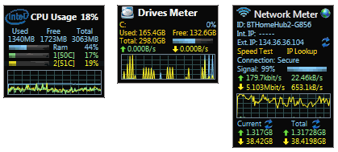
Keep an eye on it

Slide 22
The Future

Slide 23
Thread-level Parallelism
Current thinking is looking to thread-level parallelism to keep parallelism improving.
Threads are independent code sequences, so we can run threads in parallel on different processors.
Onus is now on the programmer (or their compiler!) to write code as parallel threads, rather than as a single thread which the processor computes in parallel.

Slide 24
Thread Processing
  1980 C=1, T=1 - easy
  1990 C=1, T>1 - need CPU scheduling
  2012 1≤C≤4, T>>1 - need CPU scheduling
  ~2017 C=T, T>>1 - one core per thread
  ~2020 C>T, T>>1 - ideal!

Slide 25
Other Futures

Slide 26
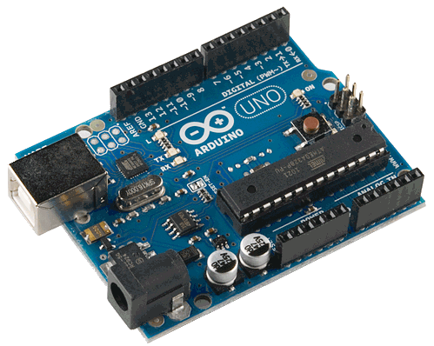
Microcontrollers
With the demand for “ubiquitous computing”, we want small, low power computers.
Microcontrollers have a CPU, some memory and I/O circuitry together on one chip.
The Arduino is a microcontroller.

Slide 27
The Transputer
In the 1980s, the Transputer was seen as the “next big thing” – it comprised a CPU, memory and communication hardware on one chip.
It (in theory) allowed hardware to be infinitely scalable … just double the number of transputers to do the job in half the time.
The transputer did not catch on, though some of the ideas in the transputer have appeared in other processors.

Slide 28

MIPS
MIPS architecture is a fully-RISC processor architecture which offers great flexibility.
MIPS has an unusual business model – they do not manufacture processors, but licence their architecture to chip manufacturers. This gives them greater design flexibility.

Slide 29
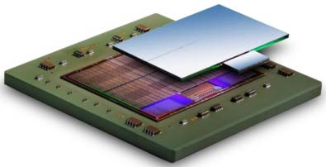
FPGA
The Field-Programmable Gate Array is rather like a writeable silicon chip.
Any logic device can be built and tested (on a computer), and then “burnt” to a FPGA.
This allows cheap and quick production of small runs of custom chips – even whole CPUs.

Slide 30
Summary
We have seen:
  superscalar architecture
  thread-level processing
  some other bells and whistles
Next meetings:
  Monday at 1600 - improving I/O
  Tuesday at 1200 - C# demos

